Slide 1
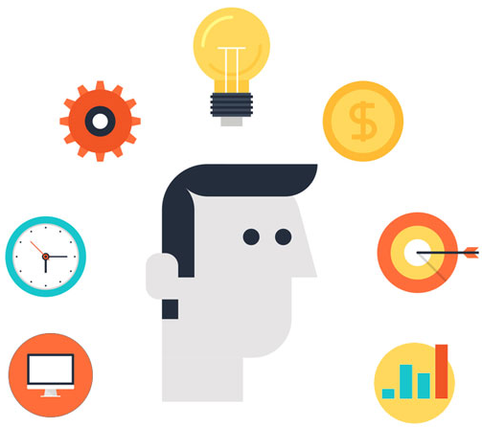

Predictive Model and it’s Result
Piyali Goswami
1st November, 2023

Slide 2
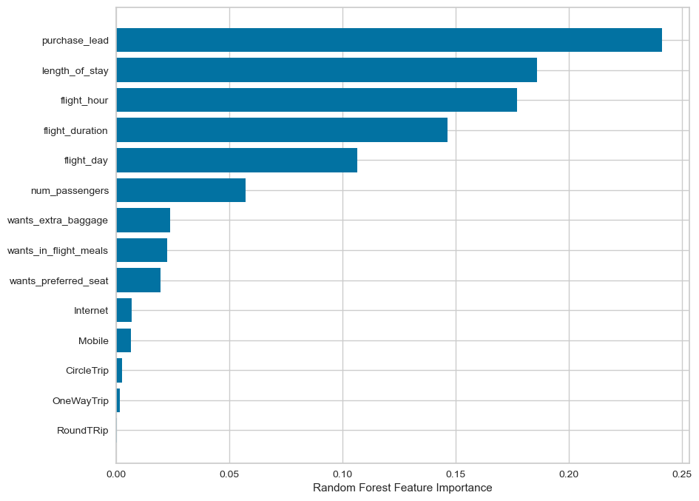
Predictive Modelling Results
Recall Rate
60%
Precision
61%
Accuracy
62%
Chance of predicting true successful bookings is 60%
66% Chance of predicting true incomplete bookings correctly
Accuracy of the model predicting successful or incomplete booking
Primary Concern: challenges in accurately predicting successful bookings.
Imbalanced Dataset: The dataset exhibits an imbalance, with 8k instances labelled as incomplete bookings and 7k as complete bookings.
Accuracy vs. Precision: Although the imbalance contributes to higher overall accuracy, it does not effectively predict successful bookings.
Top features that can drive successful flight bookings.
Specific Focus: The emphasis is on improving the model's ability to correctly identify and predict instances of successfully completed bookings within the entire set of completed bookings.

